Slide 1


Climate change
Active season ➚
Hibernation➘
Seasons length
Hibernation season conditions
Plasticity
Growing season conditions
Implications
Evolution
Body mass $↗$
Behavior
Triggers
Structure
Mass at the beginning of the active season
Mass at the end of the active season

Slide 2

Climate change
Active season ➚
Hibernation➘
Seasons length
Plasticity
Implications
Hibernation season conditions
Evolution
Body mass $↗$
Behavior
Growing season conditions
Structure
Triggers
Mass at the beginning of the active season
Mass at the end of the active season
Juveniles
Adults
Yearlings
Subadults

Slide 3

Climate change
Active season ➚
Hibernation➘
Seasons length
Plasticity
Population dynamics
Hibernation season conditions
Experience
Evolution
Behavior
Body mass $↗$
Growing season conditions
Implications
Structure
Triggers
Mass at the beginning of the active season
Mass at the end of the active season
Juveniles
Adults
Yearlings
Subadults

Slide 4
Climate change
Active season ➚
Hibernation➘
Individual variation in their plasticity ?
Season length
Plasticity
Population dynamics
Hibernation season conditions
Experience
Evolution
Behavior
Body mass $↗$
Growing season conditions
Mass at the beginning of the active season
Mass at the end of the active season
Juveniles
Adults
Yearlings
Subadults

Slide 5

Climate change
Active season ➚
Hibernation➘
Plasticity
Season length
Evolution
Body mass $↗$
Mass at the beginning of the active season
Mass at the end of the active season
Juveniles
Adults
Yearlings
Subadults

Slide 6

Active season ➚
Hibernation➘
Climate change
Individual variation in their plasticity ?
Season length
Plasticity
Evolution
Body mass $↗$

Slide 7

Climate change
Active season ➚
Hibernation ➘
Selective pressure ➘
Plasticity
Evolution
Body mass ➚

Slide 8
Climate change
Active season ➚
Hibernation ➘
Season length
Hibernation season conditions
Plasticity
Growing season conditions
Evolution
Body mass ➚

Slide 9
Climate change
Active season ➚
Hibernation➘
Season length
Plasticity
Population dynamics
Experience
Evolution
Behavior
Body mass $↗$

Slide 10
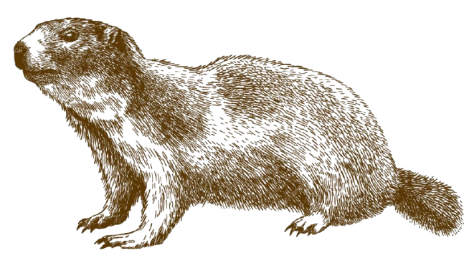
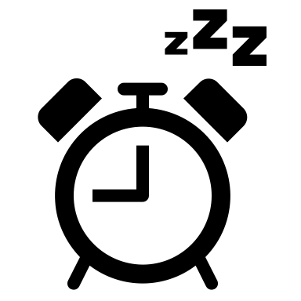


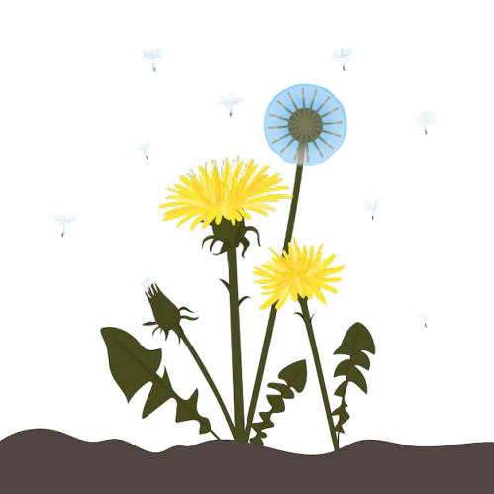
Mass ↑
September
July
Pup emergence
Pup birth
June
Emergence + Reproduction
Mass ↓︎
May
Notes:
Marmot illustration from Andrii_oliinyk (https://fr.freepik.com/auteur/andrii-oliinyk)
Dandelion illustration from key_d (https://www.freepik.com/author/keyd)

Slide 11
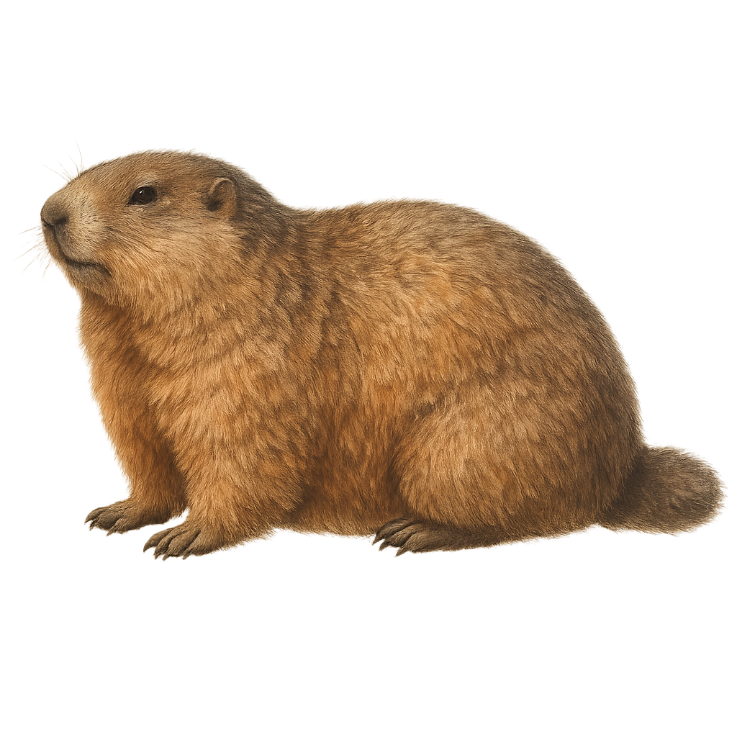
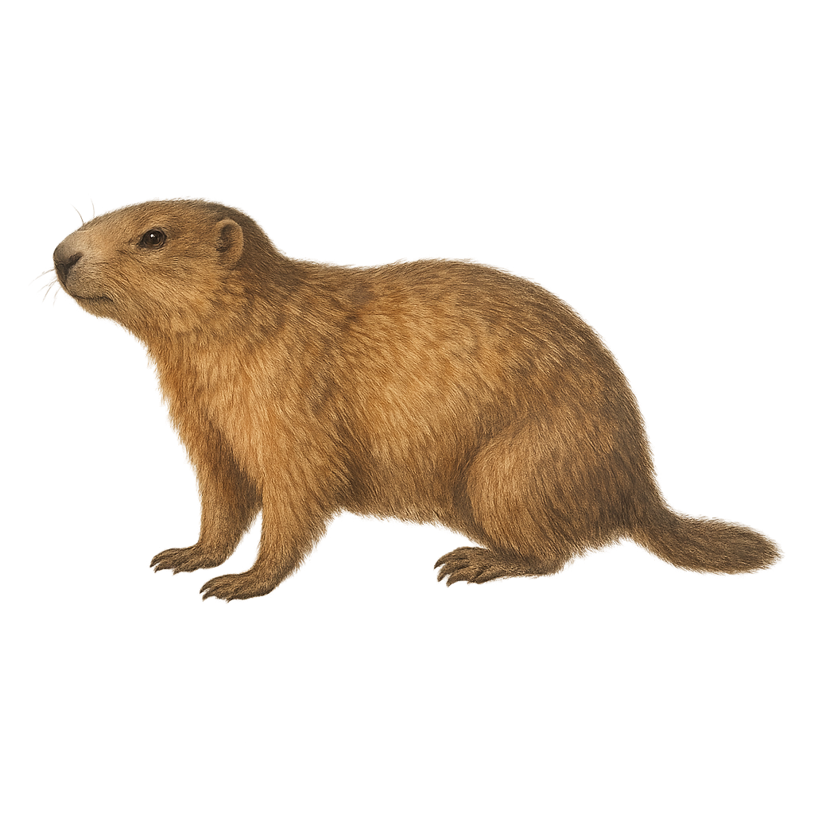
Mass ↑
September
July
Pup emergence
Pup birth
June
Emergence + Reproduction
Mass ↓︎
May
Notes:
Marmot illustration originally from Andrii_oliinyk (https://fr.freepik.com/auteur/andrii-oliinyk), then modified by AI
Dandelion illustration from key_d (https://www.freepik.com/author/keyd)

